Slide 1
Traditional Marketing Vs Digital Marketing

Slide 2
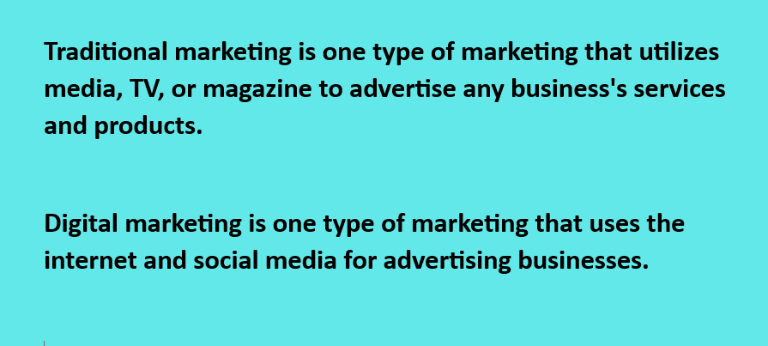
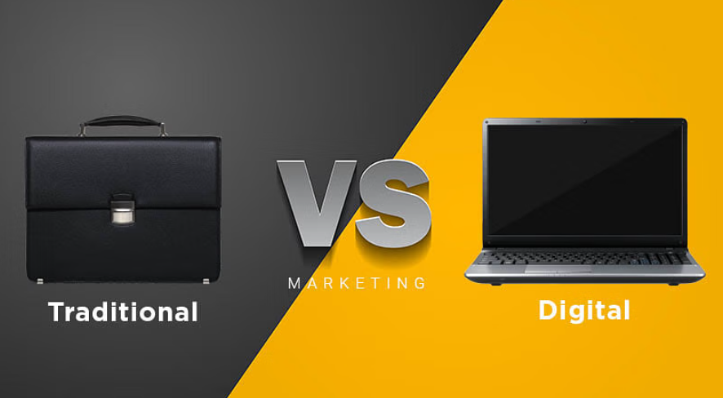
Traditional Marketing Vs Digital Marketing

Slide 3
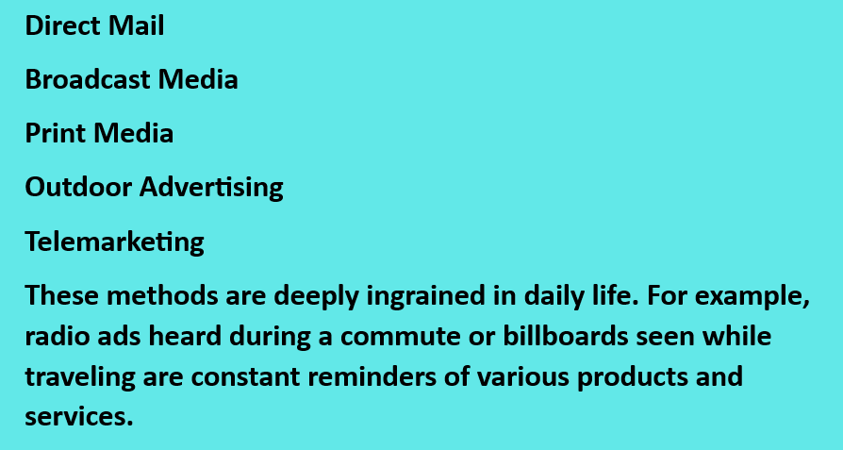
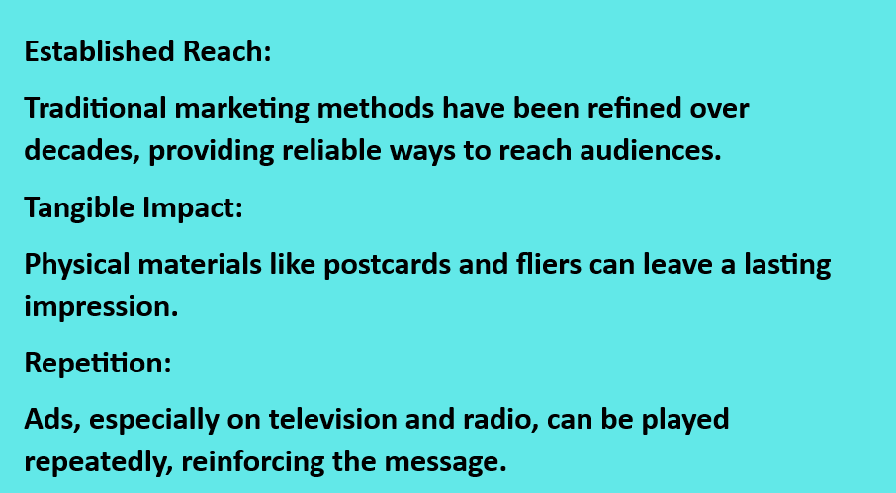
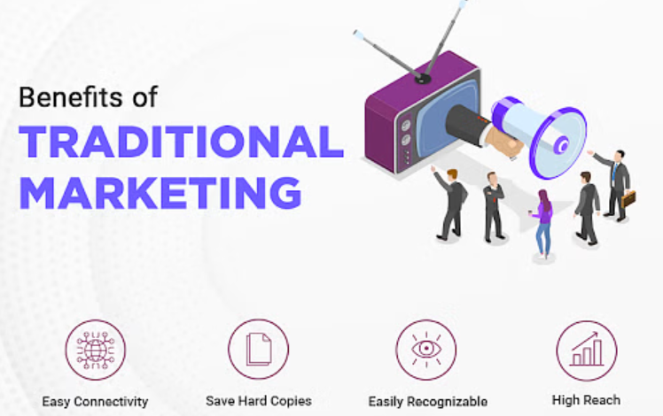
Common Methods of Traditional Marketing
Why Traditional Marketing?

Slide 4
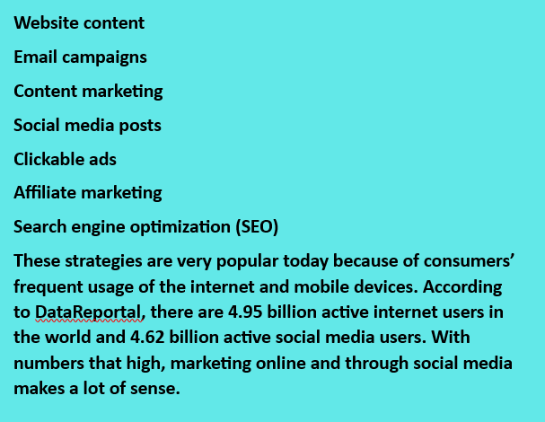
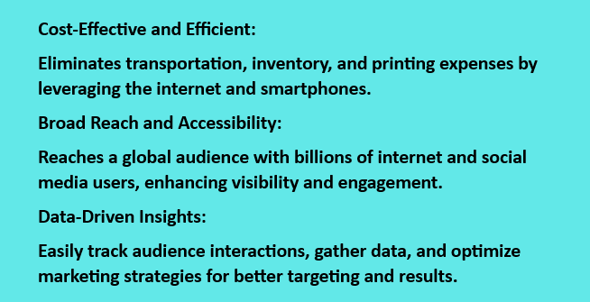
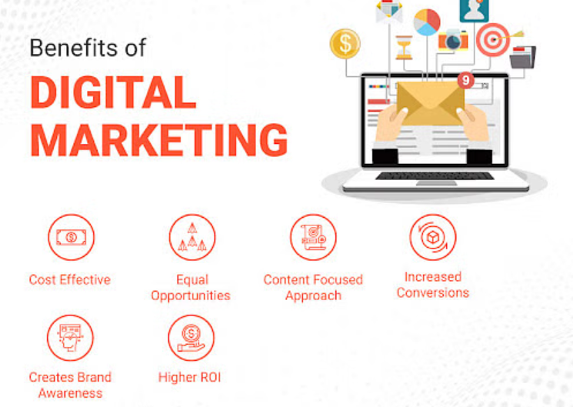
Common Methods of Digital Marketing
Why Digital Marketing?

Slide 5
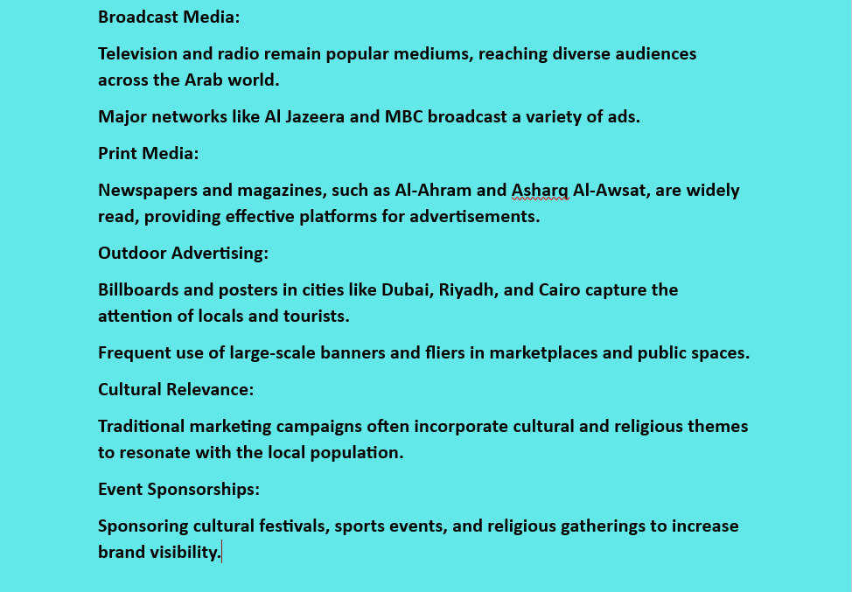
Traditional Marketing in Arab Media

Slide 6
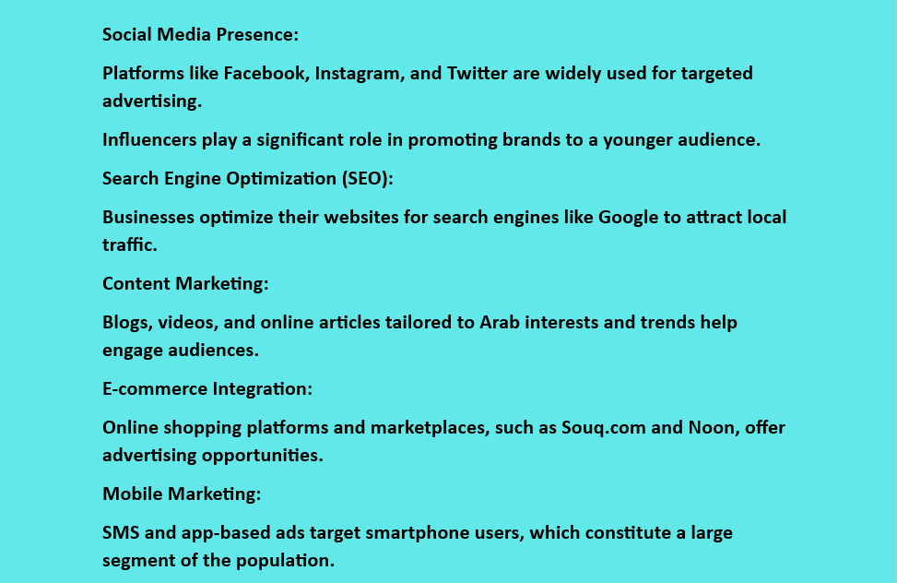
Digital Marketing in Arab Media

Slide 7
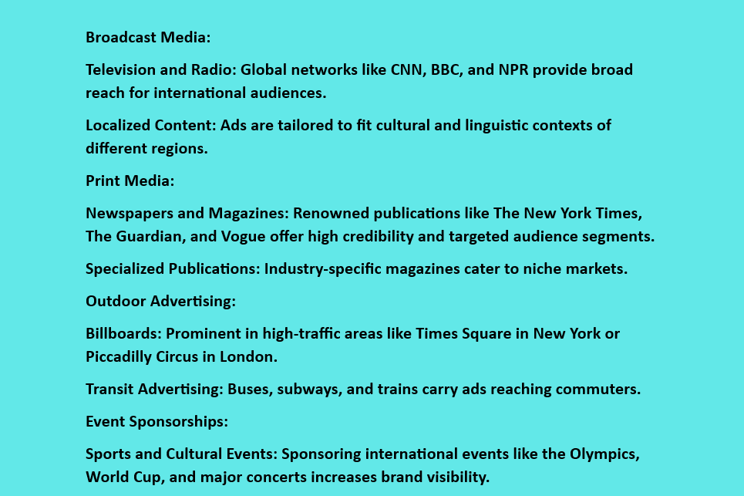
Traditional Marketing in International Media

Slide 8
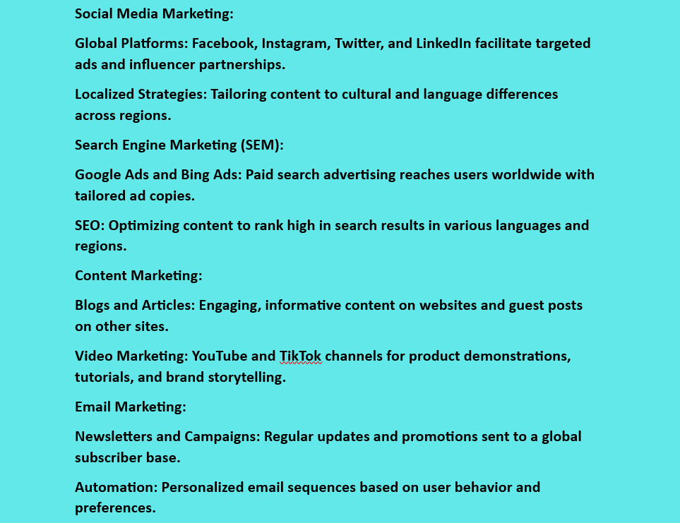
Digital Marketing in International Media

Slide 9
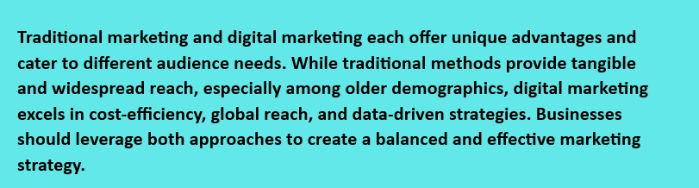
Conclusion

